Slide 1


GAME4LEARNING

Slide 2

INTRODUCTION
Games for Learning (GfL) is a growing game development company expanding to a new branch, Site B. As part of our WIL project, our group designed and implemented an IT infrastructure solution that includes a secure network, an intranet website, and a disaster recovery plan. The project allowed us to apply practical IT skills in a real-world setting while demonstrating teamwork and technical expertise.

Slide 3
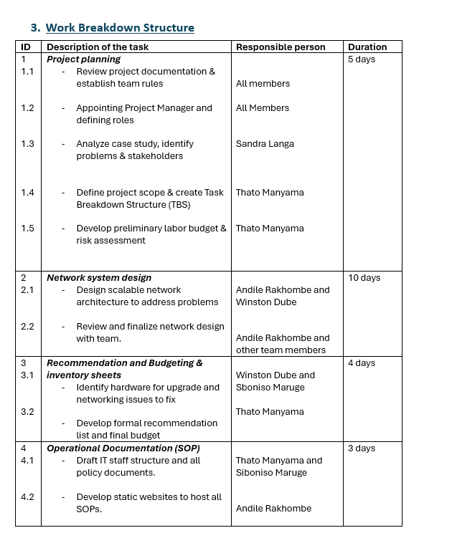
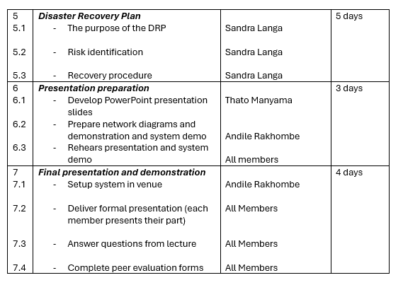
MILESTONES
Project planning and documentation
Network design and budgeting
Creating SOPs and a disaster recovery plan
Final presentation

Slide 4





RISK MANAGEMENT
People risks
Equipment risks
Economic risks
Technical risks
Project risks
Only product specifically dedicated to task management​
First beautifully designed product that's both stylish and functional
Conducted testing with start ups in the area
Designed with the help and input of software experts
Designed with the help and input of software experts

Slide 5

FEASIBILITIES
TECHNICAL FEASIBILITIES
ECONOMIC FEASIBILITY
OPERATIONAL FEASIBILITIES
SCHEDULE FEASIBILITIES
LEGAL AND ORGANISATIONAL FEASIBILITIES

Slide 6
Funding
Budget Summary:
Ø End-user devices – R464 000
Ø Servers & storage – R390 000
Ø Networking equipment – R290 000
Software Licensing – R320 000
Connectivity & ISP – R100 000
Ø Total: R1 564 050

Slide 7

NETWORK FOR SITE B

Slide 8

INTRODUCTION
​The network design for Site B was developed to provide secure, reliable, and high-performance connectivity for both administrative and development teams. It ensures smooth communication between devices, supports essential services, and allows resource sharing between Site A and Site B. The design also focuses on scalability, enabling future growth as the company expands.

Slide 9
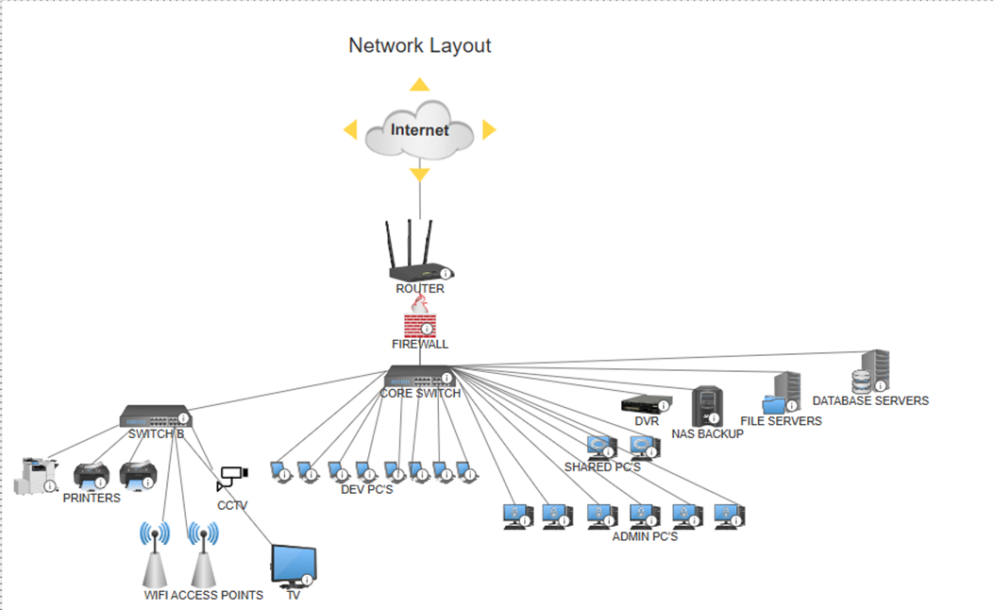
NETWORK TOPOLOGY
The Site B network follows a star topology, where all devices connect to a central switch for high reliability and easy management. This structure reduces downtime and simplifies troubleshooting. It includes VLANs for Admin, Development, Guest, and CCTV networks, each isolated for better performance and security. The network also connects to Site A via a secure VPN link for data sharing and collaboration.

Slide 10

NETWORK DEVICES AND EQUIPMENTS
​Router: Handles VPN and internet connectivity.
Firewall: Protects against cyber threats and manages access.
Core Switch: Connects all network segments with high speed.
Access Switch (PoE): Powers cameras, printers, and access points.
Wi-Fi Access Points: Provide secure wireless coverage for staff and guests.
Servers: Manage files, backups, and CCTV storage.

Slide 11

SECURITY MEASURES
The network is protected through multiple layers of security.
Firewall: Monitors and filters incoming and outgoing traffic.
VLAN Segmentation: Isolates Admin, Development, CCTV, and Guest networks to reduce risk.
VPN Connection: Encrypts communication between Site A and Site B.
User Authentication: Ensures only authorized users access resources.
Regular Backups: Protect data against loss or cyberattacks.

Slide 12
DISASTER RECOVERY PLAN

Slide 13

introduction
The Disaster Recovery Plan (DRP) ensures that Games for Learning can quickly recover from any disruption such as power failure, cyberattacks, or hardware damage. It focuses on protecting data, restoring critical systems, and minimizing downtime to maintain business continuity.

Slide 14
PURPOSE
Clear recovery procedures.
Reliable data backups.
Defined staff responsibilities.

Slide 15
OBJECTIVES
Minimizing downtime and data loss (max 24 hours lost data).
Defining roles for IT and management.
Standardizing procedures for consistent recovery.
Ensuring business continuity and compliance with POPIA.

Slide 16
SCOPE
The file server (for shared documents),
The database server (for customer data), and
Supporting systems like firewalls and authentication.
It excludes end-user devices, third-party internet services, and the new building’s network

Slide 17

RISK IDENTIFICATION
Natural disasters – use offsite backups, fire suppression.
Power issues – backup generators and UPS.
Hardware failures – RAID redundancy.
Cyberattacks – firewalls, antivirus, and staff training.
Human error – training and access control.

Slide 18

BACKUP STRATEGY
Daily full backups (on-site NAS),
Weekly offsite backups (cloud),
Monthly archives stored securely.
Backups are tested quarterly to verify data integrity.
B

Slide 19




Recovery stages
preparation
recovery
validation
Return to service
detect disaster, activate DRP, alert stakeholders
restore file and database servers from backups.
test access, confirm data integrity
resume normal operations and monitor systems

Slide 20

COMMUNICATION PLAN
During a disaster:
IT Manager leads recovery.
Network Admin restores systems.
Helpdesk supports users.
Updates are shared through email, SMS, or WhatsApp, depending on system availability.
Executives get hourly updates; employees and customers are informed as needed.

Slide 21

Review & maintenance
The DRP is reviewed every 6 months and after major incidents.
Staff receive training and simulations annually to stay prepared.
Performance metrics like downtime and recovery success are tracked for continuous improvement.

Slide 22

STANDARD OPERATING PROCEDURE (SOP)

Slide 23
Roles and responsibilities
- Created and managed the SOP document
- Ensured IT policies were clear and understandable
- Trained the team to follow procedures
- Acted as link between project plans and daily operations

Slide 24

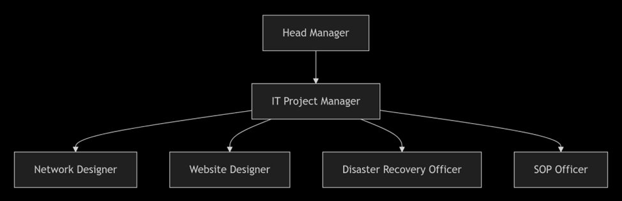
Application to the Project
- Defines “Who” – outlines IT team structure and roles
- Defines “How” – sets rules for security, purchasing, and help desk operations
- Connects Plans – translates Network & Disaster Recovery plans into daily steps

Slide 25
Key Challenge and Resolution
Challenge: Balancing detail with usability
Solution:
- Focused on user-friendly design
- Used clear, simple language and structure

Slide 26

PROCEDURES FOR REPORTING CONCERNS
User logs request via:
Help Desk Portal
Email: support@gameof learning.local
Phone: Help Desk Hotline
Walk-in (for urgent issues)
Ticket Creation & Categorization:
Issue logged with unique ticket number
Classified by type (hardware, software, network, security) and priority (Low/Medium/High/Critical) Response & Resolution:
Low priority: Resolved within 48 hours
Medium priority: Resolved within 24 hours
High/Critical: Immediate response, resolved within 4 hours Escalation Procedure:
Unresolved tickets escalated to higher-level IT staff or IT Manager Vendor support contacted if required

Slide 27

FLOOR PLAN AND INTRANET WEBSITE

Slide 28
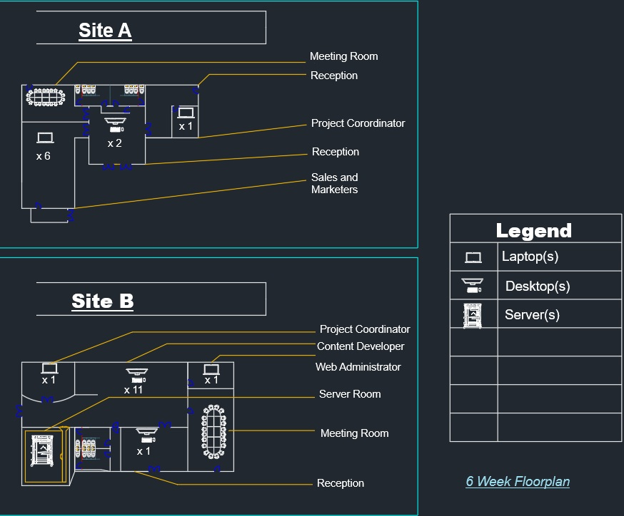
Floor plan(6 weeks)

Slide 29
Floor plan(2 months)

Slide 30
WEBSITE

Slide 31

Thank you

